Slide 1
Database Systems:
Enhanced Entity-Relationship Modeling
Prof. Dr. Taysir Hassan Abdel Hamid
IS Department
Faculty of Computer and Information
Assiut University
April 24, 2021

Slide 2
Agenda
Enhanced ER Modeling
Superclass/Subclass Relationship
Specialization/Generalization
Type Inheritance/Constraints/Updates
Categorization
Higher-Degree Relationships
Knowledge Representation
Aggregation

Slide 3
Enhanced ER Modeling
Complex databases exist, including GIS among other variety of applications.
These types of databases have more complex requirements
Semantic Data Modeling
  More complex requirements (class relationship)
  Requires more complex data modeling
  (subclass, superclass, inheritance, category)
  Enhance (extend) the simple ER model

Slide 4
Enhanced ER Modeling (Cont.)
Enhanced Entity Relationship (EER) Model
  ER model + semantic data modeling concepts
  EER Diagram

Slide 5
Superclass/Subclass
  Should have meaningful subgroupings
  Should be related to database applications
  Entities that are members of the EMPLOYEE entity may be grouped further into SECRETAERY, ENGINEER, MANAGER, and so on.
  Entity Employee is called the superclass of each
  of these subclasses
  This relationship is called superclass/class or simply class/subclass relationship

Slide 6
“IS-A” relationship
  Members of a subclass must be members of the superclass
    a FULL-TIME STUDENT is a STUDENT
  Not every entity in a superclass be a member
  of a subclass

Slide 7
Entity Type Inheritance
Type Inheritance among Classes
The type of an entity is defined by the attributes it posses and the relationship types in which it participates.
Inherited Attributes
  a subclass inherits the attributes of the superclass
  HOURLY_EMPLOYEE (Name, SSN, Address)
Local (Specific) Attributes
  a subclass may have its own attributes
  HOURLY_EMPLOYEE (Hourly_rate)
  SALARIED_EMPLOYEE (Annual_salary)

Slide 8
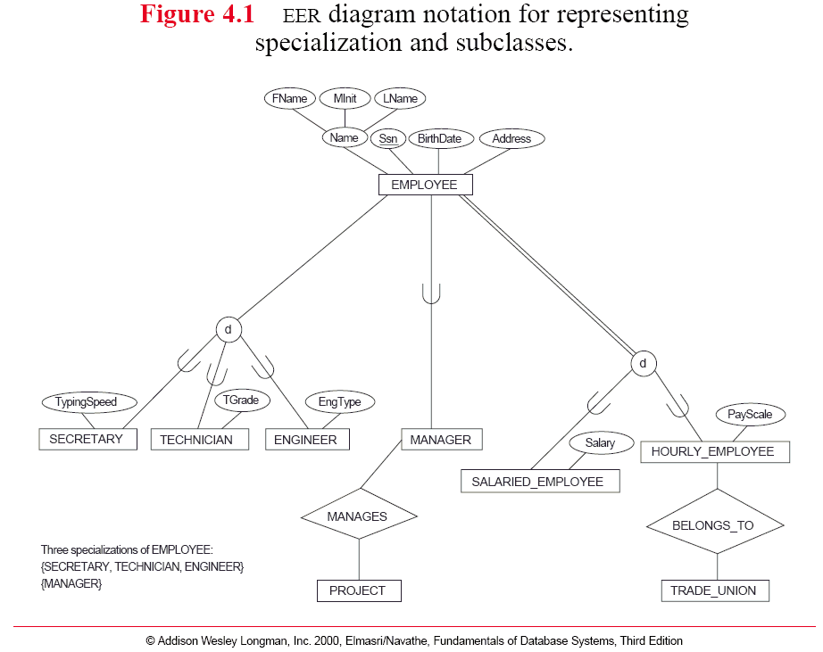
Direction of the superclass/subclass relationship

Slide 9
Relationship Type Inheritance
Inherited Relationships
  A subclass participates in the relationship type(s) of the superclass indirectly
  cared_by (INPATIENT, PHYSICIAN)
Local (Specific) Relationships
  A subclass may have its own direct relationships
  assigned_to (INPATIENT, BED)

Slide 10
Direction of the superclass/subclass relationship

Slide 11
EER Model Concepts
Subclasses
  Subgroupings of the entities of an entity type
  An entity type as a superclass of subclasses
  Examples
    EMPLOYEE ⇒ {SALARIED_EMPLOYEE, HOURLY_EMPLOYEE}
    PATIENT ⇒ {OUTPATIENT, INPATIENT}
    STUDENT ⇒ {FULL-TIME, PART-TIME}

Slide 12
Specialization and Generalization
Specialization
  Process of defining subclasses of an entity type (superclass)
  Defined on the basis of some distinguishing characteristics of the entities in the superclass.
  A (super)class ⇒ a set of subclasses
    Method of pay {SALARIED_EMPLOYEE, HOURLY_EMPLOYEE}
    Job type {SECRETARY, ENGINEER, TECHICIAN}
  Why specialization
    Attributes applied to some but not all entities
    Only members of the subclass participate in a specific relationship type

Slide 13
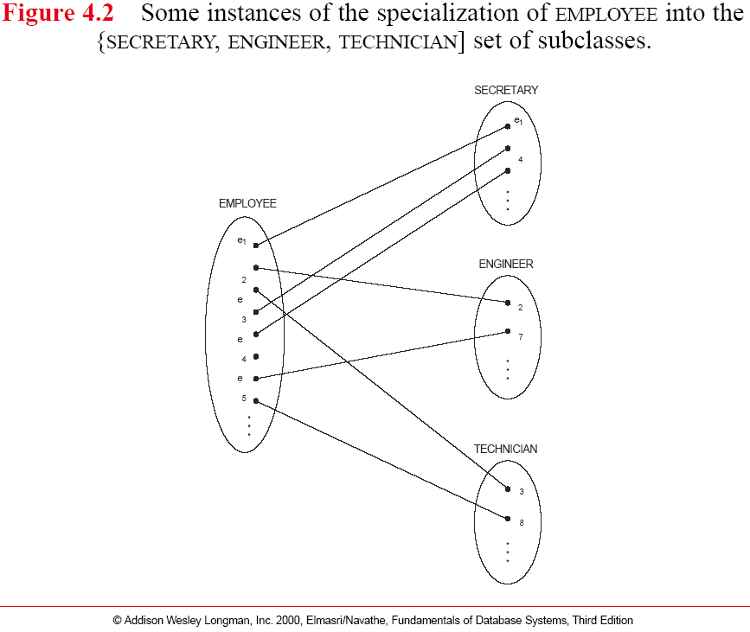
Specialization and Generalization

Slide 14
Why do we include class/subclass relationships and specializations?
Certain attributes may apply to some but not all entities of the superclass
Some relationship types may be participated in only by entities that are members of the subclass.
To summarize, the specialization process allows the following:
  Define a set of subclasses of an entity
  Establish additional specific attributes with each subclass
  Establish additional specific relationship types between each subclass and other entity types or other subclasses.

Slide 15
Generalization
  Process of defining generalized entity type from giving entity types by identifying common features (attributes)
  A set of (sub)classes ⇒ a generalized superclass
  Inverse of the specialization process
  {CAR, TRUCK} ⇒ VEHICLE : fig4.3

Slide 16
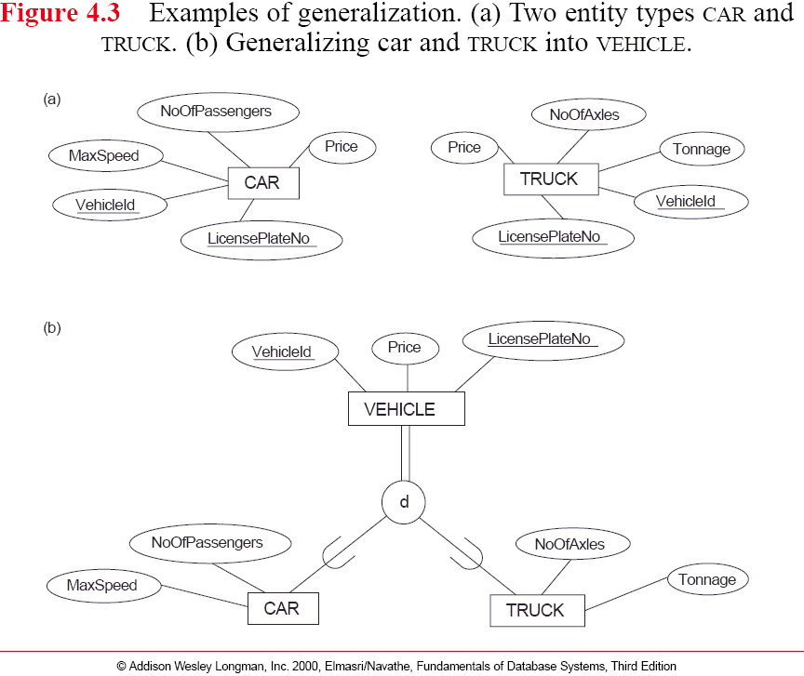
Generalized
Superclass
Subclass

Slide 17
Constraints for Specialization and Generalization
Predicate-defined subclasses:
We can determine exactly the entities that will become members of each subclass by placing a condition on the value of some attribute of the superclass.

Slide 18
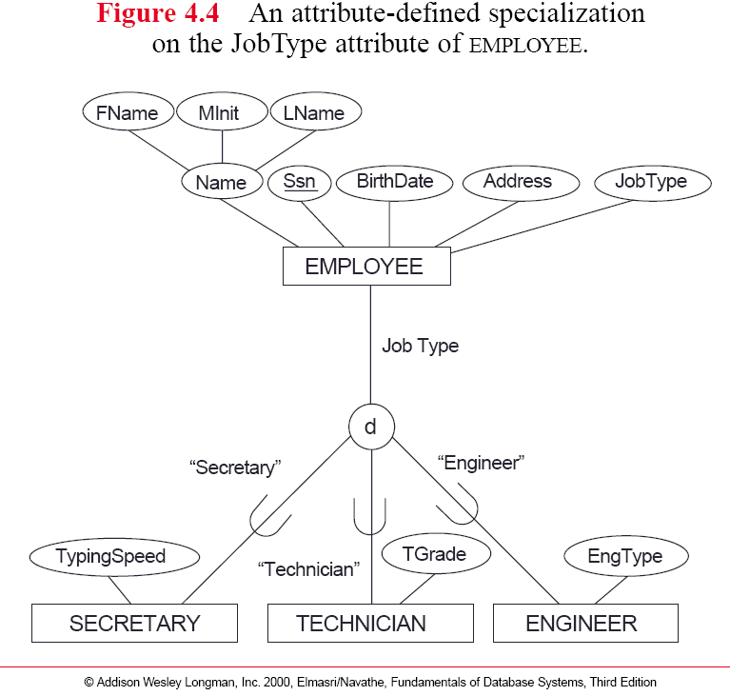
Constraints for Specialization and Generalization
Defining
attribute
Predicate condition
Predicate-defined
subclass

Slide 19
Constraints for Specialization and Generalization (Cont.)
Attribute-defined specialization
  All subclasses have their membership condition on the same attribute of the superclass
  The specialization itself is called an attribute-defined specialization and the attribute itself is called defining attribute of the specialization.
  Predicate-defined (condition defined) subclass
  JobType = ‘Engineer’ => defining predicate
User-defined Subclass
  We do not have a condition for determining membership in a subclass, the sub-class is called is user-defined
  Each membership is determined by the user

Slide 20
Constraints for Specialization and Generalization
Defining
attribute
Predicate condition
Predicate-defined
subclass

Slide 21
Two other Constraints: Disjointness and Completeness
Disjointness:
  The entity can be a member of at most one of the subclasses of the specialization
  The subclasses of the specialization must be disjoint
  No entity can be in more than one subclass
  d notation- disjoint
Overlap
  Entities may belong to several subclasses
  PERSON ⇒ {EMPLOYEE, ALUMNUS, STUDENT}
  PARTS=>{MANUFACTURED, PURCHASED} (fig4.5)

Slide 22
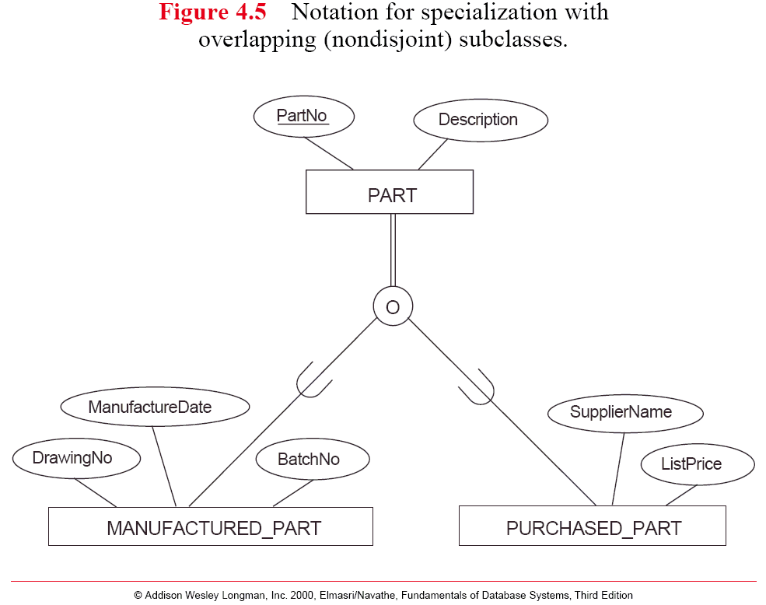
Disjointness constraints (cont.)

Slide 23
Completeness Constraints
Partial
  An entity in a superclass may not belong to any of the subclasses (fig4.6)
  {SECRETARY, ENGINEER, TECHNICIAN}
Total
  every entity in a superclass must belong to at least one of the subclasses
  {SALARIED_EMPLOYEE,HOURLY_EMPLOYEE}

Slide 24
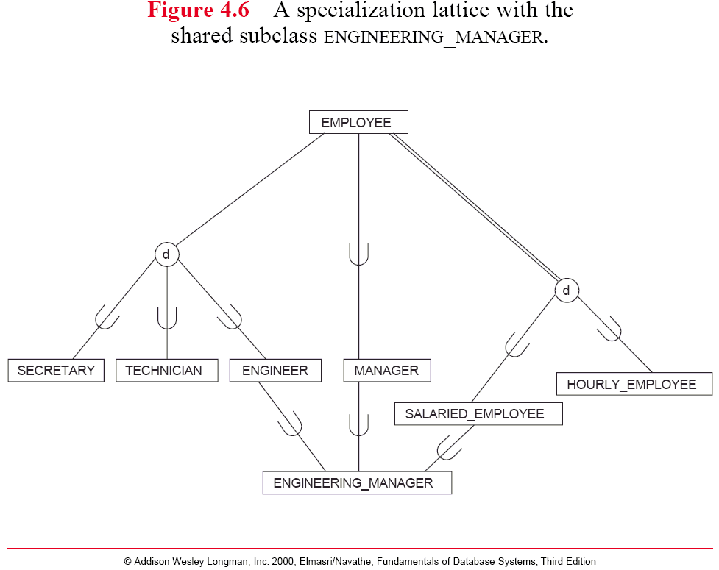
Completeness Constraints
partial
total

Slide 25
Disjointness and completeness
Independent
We have the following four possible constraints:
  Disjoint, total
  Disjoint, partial
  Overlapping, total
  Overlapping, partial
Determined by real-world meaning

Slide 26
Update rules for Specialization
Deletion cascades to subclasses
  deleting an entity in a superclass leads to the deletion of the entity in the subclasses
Insertion cascades to subclasses
  Automatic insertion of an entity in the subclass(es)
  For predicate-defined subclasses
  For total specialization

Slide 27
Specialization Hierarchy and Lattices
Specialization Hierarchy
  a subclass may have further subclasses
  every subclass has ONLY ONE superclass
  a subclass inherits the attributes/relationships not only of its immediate superclass but also of all indirect superclasses in the hierarchy
  the key of a subclass is the key of the most general superclass

Slide 28
Each subclass participates as a subclass in only one class/subclass relationship;
Each subclass has only one parent

Slide 29
Specialization Hierarchy and Lattices
Shared Subclass (fig4.7)
  a subclass with more than one superclass
  STUDENT ASST ⇐ (EMPLOYEE and STUDENT)
  Existence of shared subclass leads to lattices
Multiple Inheritance
  a shared subclass inherits attributes and relationships from multiple superclasses
  combinations of subclasses (EMPLOYEE, ALUMNUS, STUDENT)

Slide 30
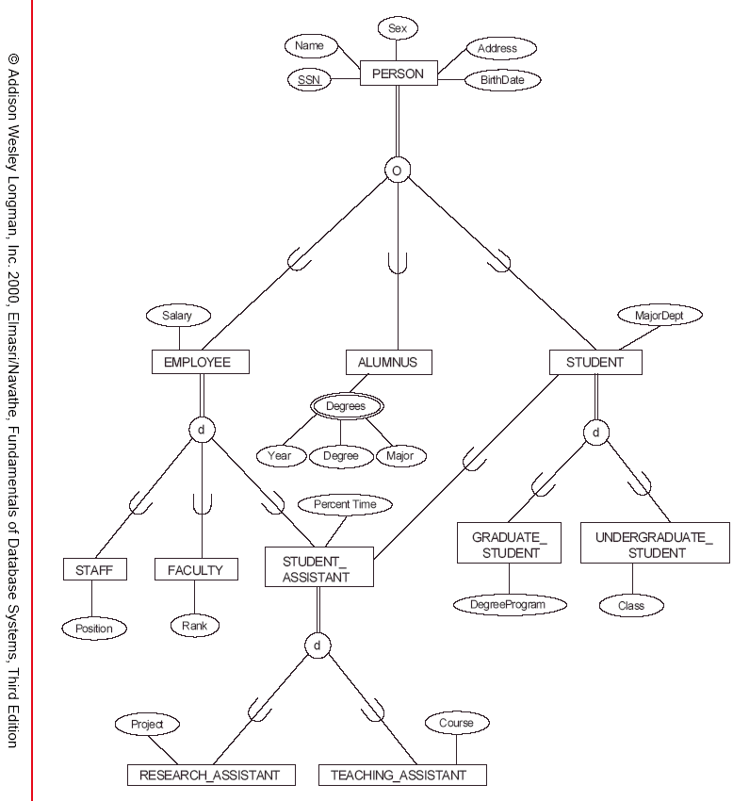
fig4.7: A Specialization lattice with multiple inheritance for a UNIVERSITY database

Slide 31
Refine Conceptual Schema Design
Specialization and generalization
Top-Down Conceptual Refinement
  Start with one entity type
  Successive specializations from a class into subclasses
Bottom-up Conceptual Synthesis
  successive generalizations by forming a superclass from several classes

Slide 32
Knowledge Representation
Knowledge Representation (KR)
  Concepts for accurately modeling some domain of knowledge by creating an ontology
  Similar to conceptual schema, but with more knowledge, rules, and exceptions
  Include reasoning mechanism that deduce additional facts from the stored facts
  Knowledge-based systems can answer queries that involve inferences over the stored data

Slide 33
Knowledge Representation
KR vs. Semantic Data Modeling (SDM)
  Both disciplines use an abstraction process to identify common properties and important aspects of objects
  Both disciplines provide concepts, constraints, operations, and languages for defining and representing knowledge
  KR is generally broader in scope than semantic models. Different forms of knowledge, such as rules (used in inference and search)
  KR schemes include reasoning mechanisms that deduce additional facts from the facts stored in the database.
  KR schemes often mix up the schemas with the instances themselves in order to provide flexibility in representing exceptions.

Slide 34
Abstraction Concepts Used in both Semantic Data Models, such as EER and KR schemes
Classification/Instantiation:
  Classification involves assigning similar objects/entities to object classes/entity types
  Instantiation is the inverse of classification and refers to the generation and specific examination of distinct objects of a class
  An object instance is related to its object class by the IS-AN-INSTANCE-OF or IS-A-MEMBER-OF relationship
Identification:
  Is the abstraction process whereby classes and objects are uniquely identifiable.
  Specialization/Generalization
Aggregation/Association

Slide 35
Aggregation/Association
Aggregation/Association
  Aggregation generates composite objects from their component objects, while association associates objects for several independent classes
  Aggregate object IS-PART-OF; the inverse is called IS-A-COMPONENT-OF
  The abstraction of association is associate objects from several independent classes.
  This abstract relationship is called
  IS-ASSOCIATED_WITH

Slide 36
Ontologies and the Semantic Web
Allow information exchange on the web.
Semantic web is creating knowledge representation models that are quite general in order to allow meaningful information exchange and search among machines.

Slide 37
Examples … GO Ontology
Molecular Function
Biological Process
Cellular Component

Slide 38
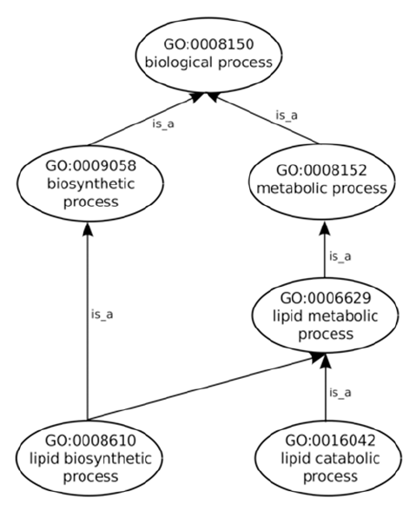


Slide 39
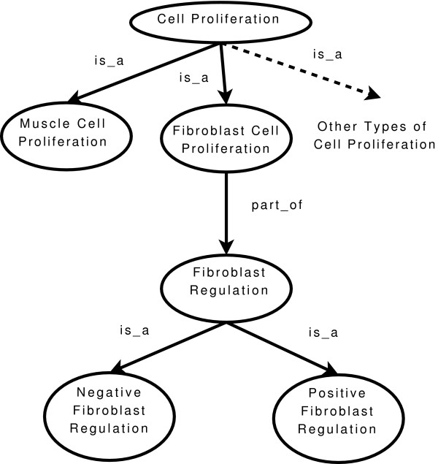

Slide 40
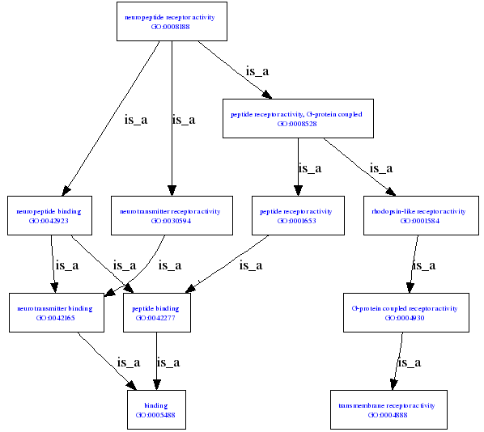
Neuropeptide receptor activity

Slide 41
Categorization by UNION
Category (Union Type)
  a subclass represent a collection of objects that is a subset of the UNION of distinct entity types. (notation, ∪)
    (CAR ∪ TRUCK) ⇒ REGISTERED_VEHICLE
  a category is a subset of the union of its superclasses
  a category has two or more superclasses
  other superclass/subclass relationships always have a single superclass

Slide 42
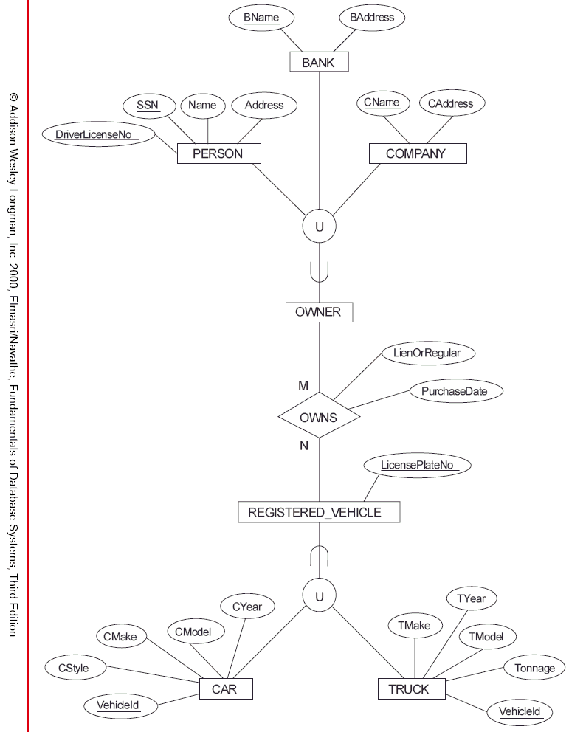
Set union operation
category
category

Slide 43
Categorization by UNION
Attributes Inheritance
  a category inherits attributes only from the single superclass it belongs to (fig4.8)
Category vs. Generalized Superclass
  (CAR ∪ TRUCK) ⇒ REGISTERED_VEHICLE
  {CAR, TRUCK} ⇐ VEHICLE (fig4.3)
  VEHICLE may include another type (e.g., MOTORCYCLE) if partial participation

Slide 44
Set union operation
category
category

Slide 45
Categorization by UNION
Category vs. Shared Subclass
  (CAR ∪ TRUCK) ⇒ REGISTERED_VEHICLE
  (GASOLINE ∩ ELECTRIC) ⇒ HYBRID
  a shared subclass is a subclass of each of the superclasses
  a shared subclass is a subset of the intersection of the superclasses
  a category is a subset of the union of its superclasses

Slide 46
Mathematical Notation
Super/Subclass Relationship
  subclass: S, superclass: C
  S ⊆ C (S is a subset of C)
  IS-A relationship: an entity in S is also in C
Specialization/Generalization
  a set of subclasses: Z = {S₁, S₂, .. , S_{n}}
  a superclass: G
  ∪ (S_{i}) ⊆ G

Slide 47
Mathematical Notation
Constraints
  Total: U (S_{i}) = G
  Partial: U (S_{i}) ⊂ G
  Disjoint: S_{i} ∩ S_{j} = φ (empty set) for i ≠ j
  Overlap: S_{i} ∩ S_{j} ≠ φ (empty set) for i ≠ j
Categorization
  a set of superclasses: (D₁, D₂, .. , D_{n})
  T ⊆ ∪ (D_{i})

Slide 48
THANK YOU

